Slide 1


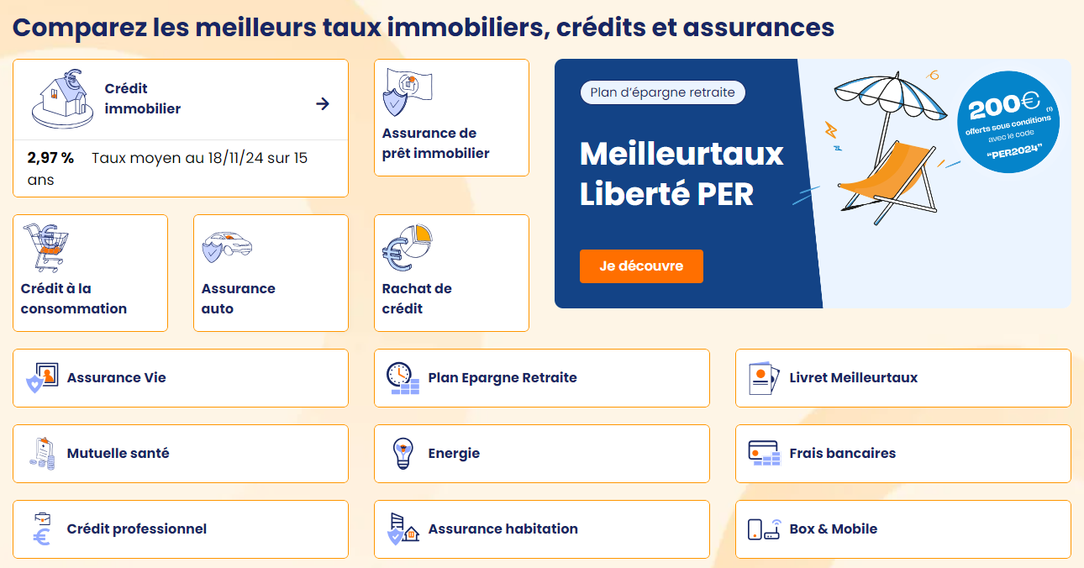
Technical Interview Presentation
December 2, 2024

Slide 2
Agenda
Introduction Global Architecture Data Analysis API FastAPI Overview Discussion Points for Interview Conclusion

Slide 3
Introduction
Overview
Project Context
Main Objective
Technologies Used
The project involves implementing a pipeline to automate the processing, analysis, and exposure of data related to mortgage loan opportunities.
The primary goal is to create a comprehensive and modular solution to meet the business needs of Julien (validation of opportunities) and Julie (marketing analysis).
Key technologies include GCP (BigQuery, Cloud run, Cloud Artifact Registry, Cloud Storage…) for cloud infrastructure, dbt for data transformation, FastAPI for API development, and Docker for containerization.

Slide 4

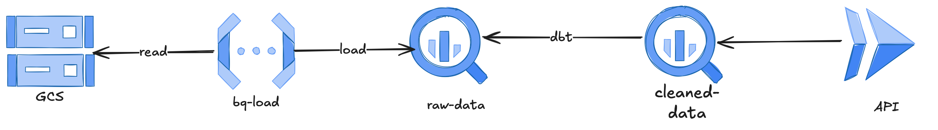
Global Architecture
01) GCF (Google cloud Storage) Store Data, tfstate, schema, staging gcf zip file.
02) GCF (Google cloud function Read / load data from GCS to BQ.
03) GCF (Google BigQuery) BigQuery initial loading of raw /gold data into tables.
04) DBT (Data build tool) / transform raw data into cleaned and enriched tables.
05) docker Build Docker images.
06) GAR (Google cloud Artifact Registry) Store / Manage / Versioning Docker images.
07) GAR (Google cloud Run) deploy Docker images.

Slide 5
Data Analysis cleaning
Data Processing
Opportunities
Proposals
Banks
Filtering ages between 18 and 80 years. Validating incomes greater than 0 and removing unnecessary columns.
Excluding ineligible proposals (Etape_Source__c). Calculating the total cost for each proposal.
Removing duplicates and standardizing names. Ensuring data is ready for actionable analyses and business decisions.

Slide 6
API FastAPI Overview
API
01
Main Endpoints
The API includes several key endpoints, notably for searching opportunities, validating them, and exporting data to Excel.
02
Search Opportunities
Criteria include age, income, and pricipal bank. Example endpoint: /search?age_min=25&revenu_min=3000&banque=BNP.
03
Validation and Export
Validation checks if an opportunity is exploitable, providing reasons if not. Excel export generates a file with opportunity details.

Slide 7
Discussion Points
Discussion
01
02
03
Technology Choices
Challenges Faced
Possible Improvements
GCP and dbt were chosen for their ability to handle large datasets and facilitate modular data transformations. FastAPI was selected for its speed and flexibility in API development.
Key challenges included validating data with strict business constraints and managing SQL query performance on BigQuery, ensuring efficient data processing.
Future enhancements could include adding load tests for the API and implementing Cloud Monitoring metrics for performance tracking.

Slide 8
Conclusion
Summary
01
02
03
Functional Pipeline
Business Impact
Future Potential
Pipeline fonctionnel avec intégration de bout en bout.
Gain de temps pour l’équipe marketing. Données fiables pour la prise de décision.
Solution modulaire et scalable pour des évolutions futures.

Slide 9

Introduction à Google Cloud
Pub/Sub.
Pub/Sub
Une solution de messagerie et de diffusion de données dans le cloud.
Presented by ing. Serges Adjomo

Slide 10




























Google Cloud Icons
AI and Machine Learning
Vertex AI
AutoML
AutoML
Natural Language
AutoML
Tables
AutoML Translation
AutoML
Video Intelligence
AutoML
Vision
Cloud
Inference API
Cloud
Talent Solution
Cloud
Natural Language API
Cloud TPU
Cloud
Translation API
Cloud
Vision API
Data Labeling
Speech-to-Text
Text-to-Speech
Video Intelligence API
Document AI
Document AI
Warehouse
Visual Inspection AI
Google Cloud products and services not represented here with a unique icon should use this generic icon.
Retail API
Recommendations AI
Cloud AI
Contact Center AI
Contact Center AI Platform
Dialogflow Enterprise Edition
Agent Assist
Notes:
Reviewing request to add Data Labeling Service

Slide 11


























Google Cloud Icons
Compute
Serverless
Compute Engine
Google Kubernetes Engine
VMware Engine
Bare Metal Solution
Cloud GPUs
Distributed
Cloud
Container- Optimized OS
Cloud Functions
Cloud Run
App Engine
Cloud Endpoints
API Gateway
Analytics
BigQuery
Cloud
Composer
Cloud
Data Fusion
Data Catalog
Dataflow
Dataprep by Trifacta
Dataproc
Life Sciences
Pub/Sub
Datastream
Healthcare API
Looker
Google Data Studio
Dataplex
Analytics Hub

Slide 12










Google Cloud Icons
Operations
Cloud APIs
Cloud Billing API
Cloud Deployment Manager
Cloud Logging
Cloud Monitoring
Cloud Shell
Error Reporting
Cloud Profiler
Cloud Trace
Backup and DR

Slide 13



















Google Cloud Icons
Networking
Cloud Armor
Cloud CDN
Cloud DNS
Cloud External IP Addresses
Cloud Firewall Rules
Cloud Interconnect
Cloud Load Balancing
Cloud NAT
Cloud Network
Cloud Routes
Cloud Router
Cloud VPN
Partner Interconnect
Premium Network Tier
Standard Network Tier
Traffic Director
Virtual Private Cloud
Network Intelligence
Cloud Domains

Slide 14













Google Cloud Icons
CI/CD
Integration Services
Cloud Code
Cloud Scheduler
Cloud Tasks
Apigee API Management
Workflows
Cloud Build
Firebase Test Lab
Container Registry
Artifact
Registry
Cloud Deploy
Application Integration
Integration
Connectors
Eventarc

Slide 15









Google Cloud Icons
Internet of Things
Cloud IoT Core
Databases
Cloud Bigtable
Cloud Spanner
Cloud SQL
Datastore
Firestore
Memorystore
BigQuery
AlloyDB
Database Migration Service

Slide 16







Google Cloud Icons
Storage
Cloud Storage
Filestore
Persistent Disk
Data Transfer
Hybrid and Multicloud
Traffic Director
Anthos
Anthos clusters
Anthos Service Mesh

Slide 17














Google Cloud Icons
Security
Cloud Identity
Data Loss
Prevention API
Managed Microsoft AD
Secret
Manager
Identity & Access Management
Cloud Resource Manager
Web Security Scanner
Cloud Key Management
Security Command Center
Migration
Transfer Appliance
Migrate for Compute Engine
Migrate to Containers
Database Migration Service
Storage Transfer Service
Cloud Data Transfer
BigQuery Data Transfer Service

Slide 18





Open Source Icons
Kubernetes
Name Kubernetes
Name Kubernetes
Kubernetes
TensorFlow
Name TensorFlow
Name TensorFlow
TensorFlow
Forseti Security
Name Forseti Security
Name Forseti Security
Forseti Security
Istio
Name Istio
Name Istio
Istio

